Slide 1


Oddball ETL Pipeline
A robust ETL solution delivering clean datasets for local or Databricks deployment.
Omer Hassan
9/2/2025

Slide 2



Pipeline Architecture
Extract
Transform
Load
Pull data from GitHub repositories and APIs
Apply Python-based data transformations and cleaning
Deploy to local storage or Databricks platform
Streamlined three-stage process ensures consistent data quality across deployment environments.

Slide 3
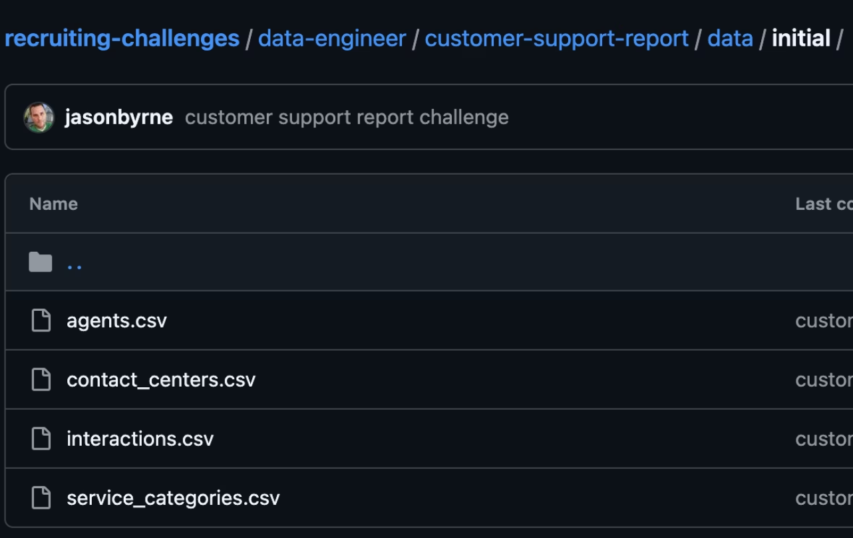
GitHub Data Extraction
Source Data
Key Files: agents, interactions, contact_centers, service_categories
Data is monthly, with deltas applied for updates

Slide 4
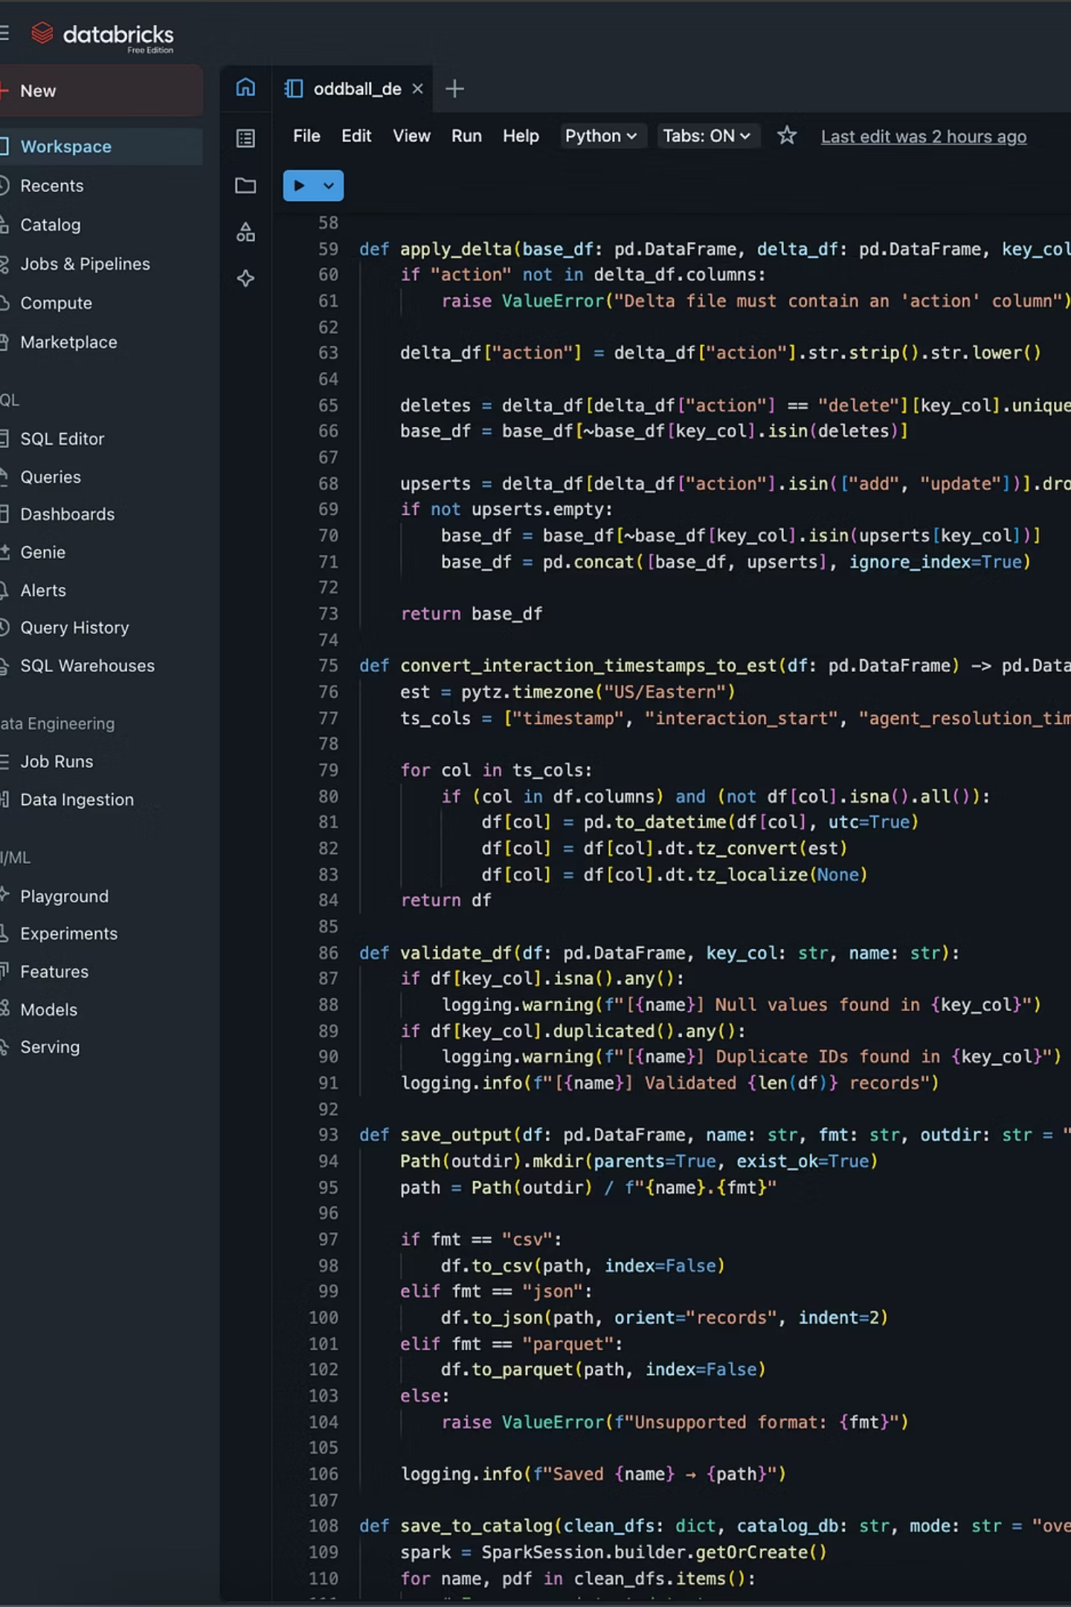
Python Transformation Engine
Unified Logic
Requirements Handling
Both deployment scripts apply identical transformation functions, ensuring consistent data processing regardless of target environment.
Applied Deltas
Timestamp conversion
Data Type Standardization
Validation
Optimized Performance
Efficient Python operations minimize processing time while maintaining data integrity throughout the pipeline.

Slide 5


Flexible Deployment Options
Local Deployment
Databricks Cloud
Run the pipeline on your local machine for development, testing, or smaller datasets. Perfect for proof-of-concept work or individual analysis projects.
Scale to enterprise-level processing with Databricks integration. Leverage distributed computing power for large datasets and production workloads.
Two scripts, same transformations - choose the environment that fits your needs.

Slide 6

Data Quality Framework
Constraint Validation
Automated checks ensure referential integrity and data type compliance across all tables.
Null Handling
Smart functions identify and resolve missing data using business logic and fallback values.
Duplicate Detection
Advanced algorithms detect and merge duplicate records while preserving data lineage.
Comprehensive quality controls produce the cleanest possible datasets for downstream analysis.

Slide 7

Pipeline Benefits
2
100%
4
Script Options
Data Consistency
Core Tables
Local and Databricks deployment flexibility
Structured data foundation for analysis
Identical transformations across environments
Automated quality controls and flexible deployment options deliver reliable, clean datasets ready for immediate use.

Slide 8



Ready to Deploy
Run the Pipeline
Configure GitHub Access
Execute your chosen script and monitor the transformation process for clean, analysis-ready data.
Choose Your Environment
Set up API credentials and repository permissions for data extraction.
Select local or Databricks deployment based on your scale and infrastructure needs.

